Slide 1
Revolution in Rail
Scott Prentice
Head of Business Development

Slide 2
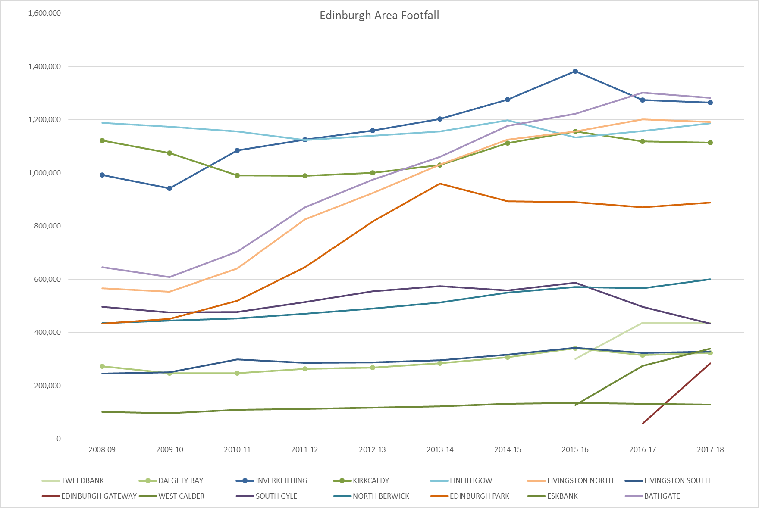
The problem?

Slide 3
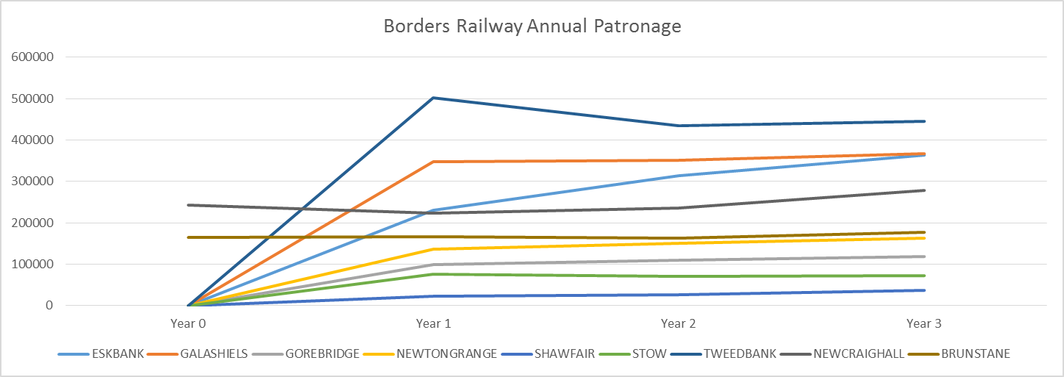
Borders railway - a success
Patronage: 4m journeys to / from the 7 news stations in 3 years
Daily Seats provided: peak capacity up from 1,224 to 1,717 (40%)
Performance hasn’t been good enough

Slide 4
Where do customers travel?

Slide 5
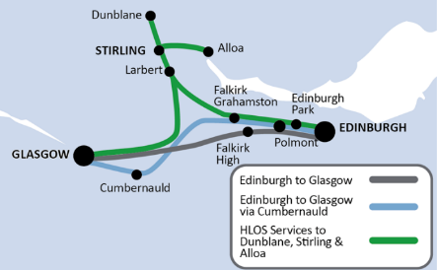
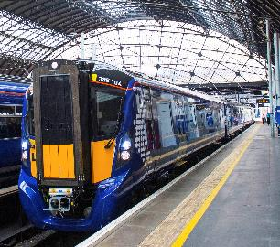
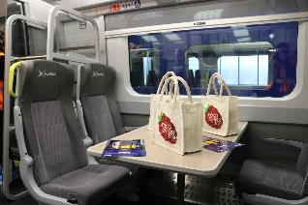
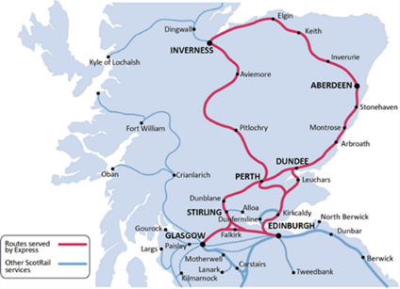
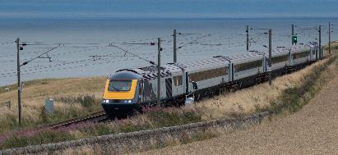
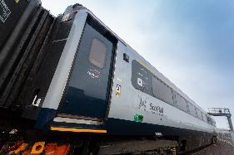
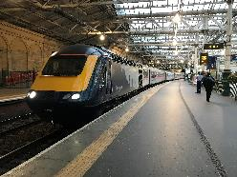
Our new trains
Class 385 Electric Multiple Units – 70 trains
North Berwick
Shotts
Lanark
High Speed Trains – 26 trains

Slide 6
Intercity Corridors
2018
Aberdeen – Glasgow
Benefits
c80 additional services per day
>20,000 additional seats per day
5-10 min reduction in average journey times to / from Aberdeen
4,000 additional seats per day introduced to Dundee – Arbroath corridor
Daily services at Broughty Ferry increase by 125% from 16 to 36
Daily services at Monifieth increase by 300% from 7 to 28
Daily services at Carnoustie increase by 30% from 34 to 45
Daily services at Arbroath increase by 45% from 61 to 90
5,000 additional seats per day introduced between Montrose and Aberdeen
Montrose services increase by 75% from 52 to 91
Laurencekirk services increase by 65% from 24 to 40
Stonehaven services increase by 40% from 50 to 71
Portlethen services increase by 105% from 20 to 41
2019
Inverness – Edinburgh & Glasgow
2019
Benefits
8 additional services per day
50% increase in seats compared to today: from 4,100 to 6,600 per day
5-10 min reduction in average journey times to / from Inverness

Slide 7
Dunblane – Edinburgh Corridor
2018
Messages
Falkirk Grahamston now comparable to Falkirk High: 4 tph to Edinburgh and 2th to Glasgow. Will support town centre regeneration and is easier to access for Bainsford, Grangemouth, Middlefield areas – plenty of car parking at station
Cumbernauld route now has fit for purpose service with direct trains to Edinburgh and Glasgow – no longer the “Cinderella” route Ideal for those living within active travel distance from Cumbernauld, Greenfaulds, Stepps & Gartcosh – no need to drive to Croy
“Virtual” capacity increase at Polmont and Linlithgow
Timetable structure
38 additional services between Falkirk – Glasgow
c7,000 additional seats between Falkirk & Glasgow
59 additional services between Falkirk – Edinburgh
c11,000 additional seats between Falkirk & Edinburgh
More evening services between Dunblane & Edinburgh
Journey Time and Frequency
Stirling to Edinburgh reduces to around 45min
Falkirk Grahamston has 4tph to Edinburgh and 2tph to Glasgow
New half hourly direct service from North Lanarkshire to Falkirk, West Lothian and Edinburgh

Slide 8
December 2018
More services
New half hourly Edinburgh to Glasgow via Falkirk Grahamston service
New close to hourly Dundee to Arbroath local service
New hourly Aberdeen to Montrose local service
New close to hourly Inverness to Elgin local service
More seats
All Edinburgh to Glasgow via Falkirk High services operated by 7 carriage Hitachi class 385 trains (9,500 more seats)
Most Edinburgh to Dunblane services operated by 4 carriage class 365 electric trains (4,000 more seats)
Half of Glasgow to Alloa / Dunblane services operated by 6 carriage class 385 Hitachi class 385 trains (3,500 more seats)
Most North Berwick peak services operated by 6 carriage Hitachi class 385 trains (1,500 more seats)
More 3 carriage class 170 trains operating off peak services on Borders
Glasgow Central to Neilston services increase from 3 to 4 car
Most Airdrie to Balloch services increased from 3 to 6 cars
Reduction of class 314 operation in Inverclyde (down from 63 services to 29 per day)
HST will operate 48 out of 99 intercity services
4 out of 22 Aberdeen – Inverness
6 out of 22 Inverness – Edinburgh & Glasgow
19 out of 24 Aberdeen – Edinburgh
19 out of 31 Aberdeen – Glasgow
Faster Journeys – Phase 1: E&G, Stirling area, Inter7city

Slide 9
2019
More services
New Highland Main Line timetable
New Edinburgh to Glasgow via Shotts timetable using modern electric trains
New hourly Dundee to Glasgow regional service
New Half hourly Inverurie to Aberdeen and hourly Aberdeen Crossrail
Recast Fife timetable
More seats
Edinburgh to Glasgow services formed of 8 carriage Hitachi class 385 trains
Edinburgh to Dunblane services formed of 4 carriage Hitachi class 385 trains
Glasgow to Dunblane / Alloa services formed of 6 carriage Hitachi class 385 trains
Edinburgh to North Berwick services formed of 6 carriage Hitachi class 385 trains
Most Glasgow to Neilston and all Carthcart Circle services increased from 3 and 4 to 6 car
Most East Kilbride peak services increased from 4 to 6 car
More Barrhead peak services increased from 2 to 4 car
More Larkhall and Dumbarton to Springburn peak services formed of 6 cars
Full withdrawal of class 314 on Inverclyde and South Electrics. Replaced by class 318/320 and 385
Most Fife services formed of 6 carriage trains
Most Borders services formed of 3 carriage trains with up to carriages in peaks
High Speed Trains from 69 and then all 104 intercity services (includes enhanced HML)
Faster journeys (Phases 2 and 3): E&G, Stirling area, Inter7city, A2B

Slide 10
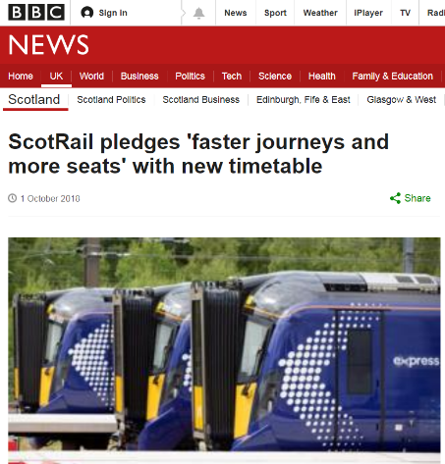
We need your help
Communications have started
Regional programme of announcements follow shortly
Explain the benefits
Everyone benefits from more capacity
The majority benefit from much faster journeys
A minority of journeys are poorer under the new timetable structure
c5,000 daily journeys between Stirling area and Edinburgh are 10-15min faster
c300 daily journeys are less convenient (Polmont and Linlithgow to Stirling)
Others include Dunlane “express”, Angus commuter and North Berwick through services
Explain this is a phased introduction
We are delivering early benefit rather waiting for everything to align so we can introduce the “perfect” timetable
We need feedback so learnings can be incorporated in future phases
Plan to build on proven stakeholder engagement to get best Shotts and Fife timetables

Slide 11
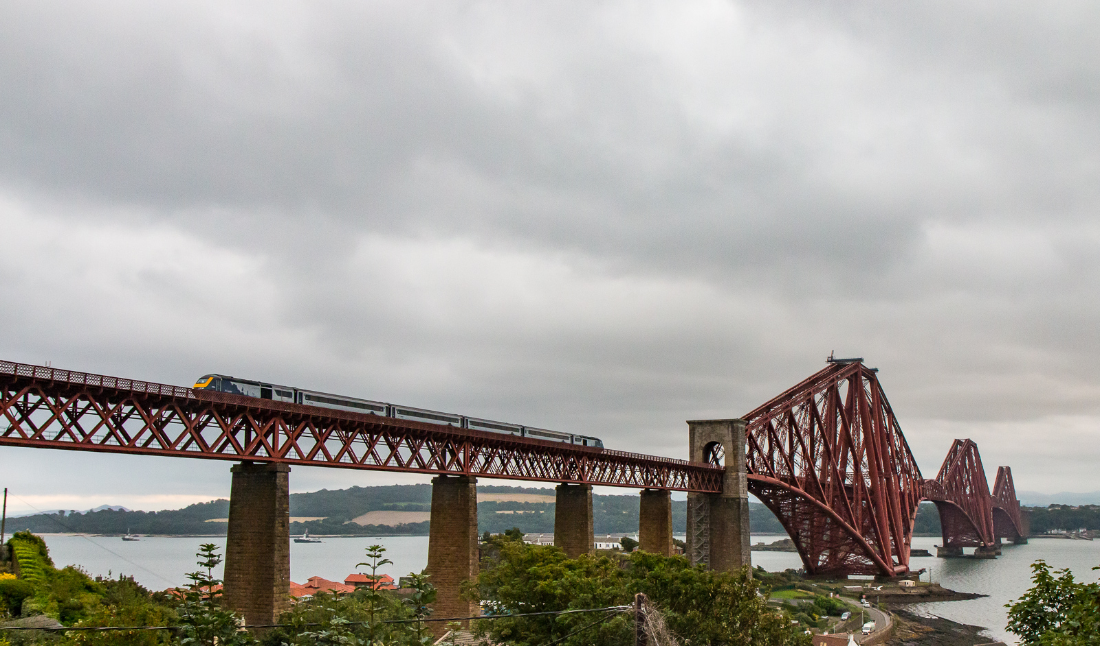
Thank You and Questions

